Slide 1
Secure data hiding in images using steganography
CAPSTONE PROJECT
Presented By:
Student Name : GANGI BHAVANI SANKAR
College Name & Department : SRI VENKATESWARA COLLEGE & MBA

Slide 2
OUTLINE
Problem Statement
Technology used
Wow factor
End users
Result
Conclusion
Git-hub Link
Future scope

Slide 3
Problem Statement
This project addresses the security problem of transmitting the data over internet network.
How can we send a message secretly to the destination.
Using steganography, information can be hidden in carriers such as images, audio files, text files, videos and data transmissions.
Without this type of encryption, unauthorized people are able to read messages that should remain secret.
As an encrypted message gets attention on the internet and can be easily decoded with the help of cryptanalysis to solve this detect.

Slide 4
Technology used
CV2 libraries
OS libraries
STRING libraries
VS Code
Hardware Specification :-
Processor Intel processor I3 or above
RAM 1 GB or above
ROM 500 MB or above
Software Specification:-
Software used Python IDLE
Operating System Microsoft Windows 7 or above

Slide 5
Wow factors
Concealment: One of the benefits of steganography is that it allows for the concealment of information, making it difficult for third parties to detect the existence of a message or file.
Security: By hiding information in another file or message, steganography can provide an additional layer of security, protecting data from unauthorized access.
Digital Watermarking: It can be used to embed digital watermarks, which can be used to identify the source of a file or detect unauthorized copies.
Evasion Of Detection: It can be used to evade detection by firewalls, intrusion detection systems, and other security measures.
Resistance to Tampering: Because the hidden information is embedded in another file or message, it is less likely to be tampered with, making it more secure.

Slide 6
End users
Military: Securing the data during transmission is of utmost importance these days. The confidentiality, integrity, and availability of the data are at risk because of the emerging technologies and complexity in software applications, and therefore, there is a need to secure such systems and data
Transmitting sensitive information is critical in military and government communication as it supports decision making, strategic planning and operation success. This critical information, however, is exposed because the existing messaging apps are not sufficient, and it could compromise national security and threaten missions. Without this type of encryption, unauthorized people are able to read messages that should remain secret. As an encrypted message gets attention on the internet and can be easily decoded with the help of cryptanalysis to solve this detect.

Slide 7
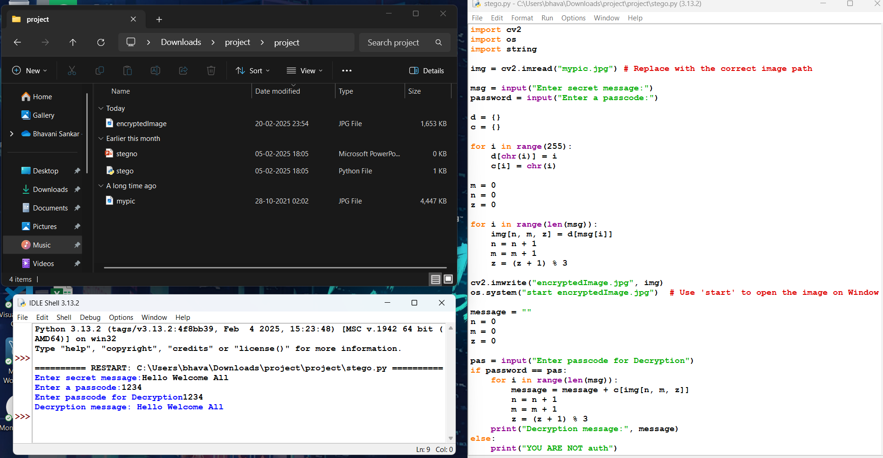
Results

Slide 8
Conclusion
Steganography is more of a concept than a method of data delivery by secretive methods. This makes the application of Steganography easier in more than one clever way. Steganography is significantly more sophisticated than before. It is often paired with cryptography for double protection. In areas where cryptography and strong encryption are being outlawed, citizens are looking at steganography to circumvent such policies and pass messages covertly.

Slide 9
GitHub Link
https://github.com/sankar0203/stegoFile.git

Slide 10
Future scope(optional)
We have proposed this algorithm for static images, and the quality of steganography is kept high. Video are still a new topic of research and requires more commitment than the image steganography. Although we all are known that videos are nothing but the grouping of frames per second. If we can capture the frames and become able to modify them and retransmit as the order they appeared will give us a chance to implement the video steganography. So what we will try to use this research in video based steganography and keep the standards as high as we did for the still images.

Slide 11
THANK YOU

